Slide 1

Leith Academy
School of Football

Slide 2
School of Football
Leith Academy will be entering its third year of running the School of Football subject.
School of Football helps pupils learn through football.

Slide 3
What is a School of Football?
Football is now a subject within Leith Academy
Social & Academic Programme (Practical & Theory)
5 Sessions per week
To attend SoF you will be ‘extracted’ from other subjects.
Delivered by a UEFA B Licenced Coach. Mr Moffat from Leith Academy and Gary Hocknull from the Hibernian FC Community Foundation.

Slide 4
Aims – Person 1st, Player 2nd
Academically
Commitment to school
Growth Mind-set
All aspects of school
Learning
Collaboration
Communication
Socially
Friendships
Confidence
Self Esteem
Maturity & Responsibility
Respect

Slide 5
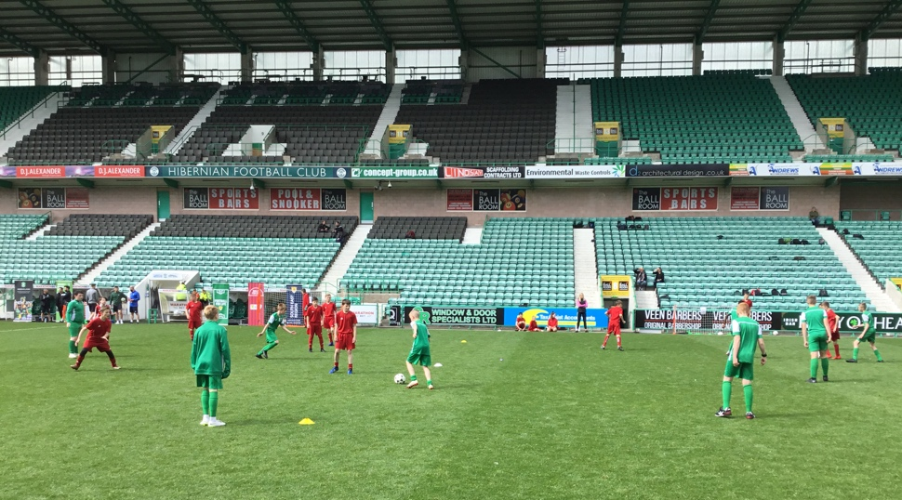
SOF Programme
Technical & Tactical Sessions
Athletic Development
Small Sided Games
Nutrition
Positive Coaching Scotland
Strength & Conditioning
Psychology
Literacy & Numeracy

Slide 6
The Experiences of our Pupils
Through our partnerships, the pupils’ have been fortunate enough to participate in a wide range of activities.
From ‘Athletic Diet’ workshops and hosting a welcome evening at Easter Road to training at the National Performance Centre and working collaboratively with other year groups.

Slide 7
Supported by our School
Head teacher Mike Irving shares his view on the School of Football:
‘We are in our second year of The School of Football program at Leith Academy and it has had a positive impact on the youngsters involved. Taking a strength based approach to our curriculum design has allowed us to use football as a vehicle to improve a whole range of aspects across the individual. The program helps young people develop their skills of communicating, working together, creativity and problem solving whilst at the same time develops their ability to play and develop their performance levels.
The success of the work we do with our School of Football is hugely linked to our positive and growing partnership with Hibernian Football Club and the Scottish Football Association. Between the football clubs, the school and the families of the players we have a powerful combination which undoubtedly impacts positively on the young people of Leith. We look forward to the program growing over the coming years.’

Slide 8
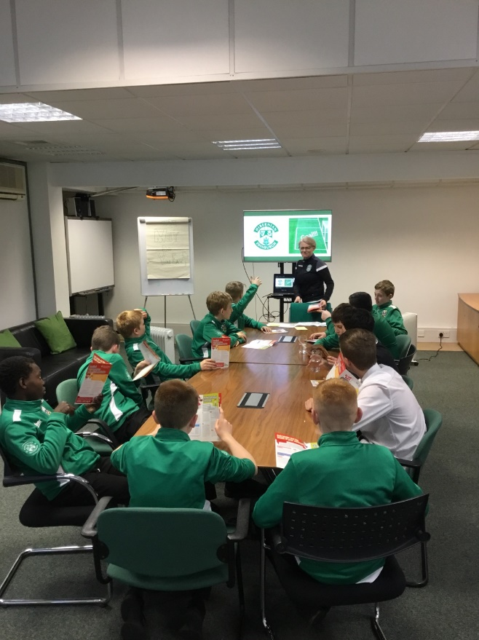
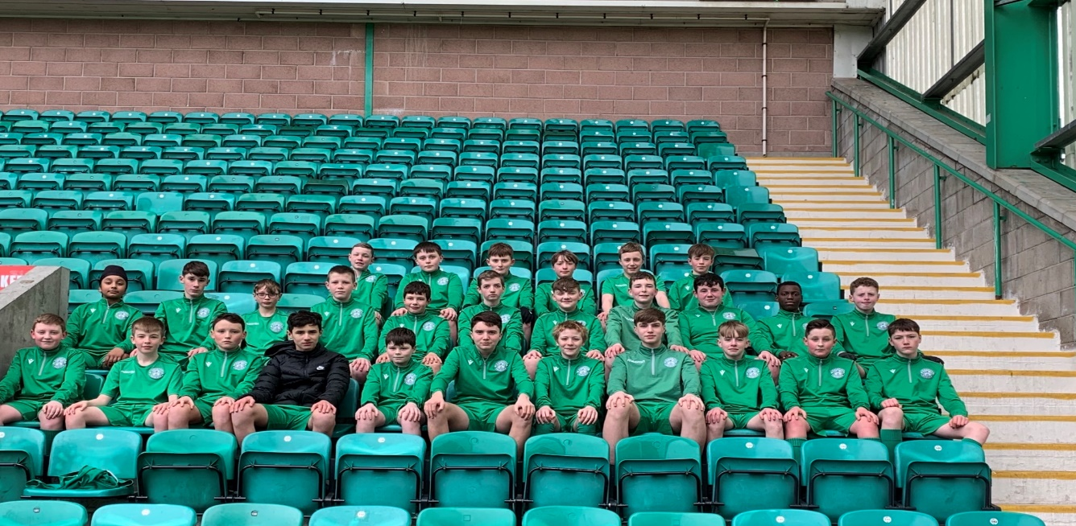
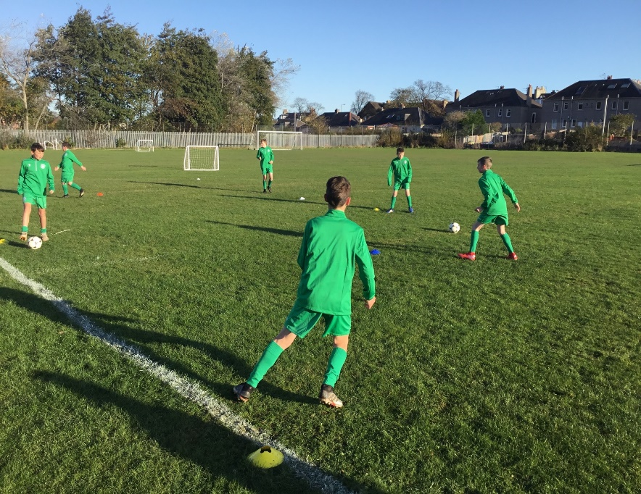
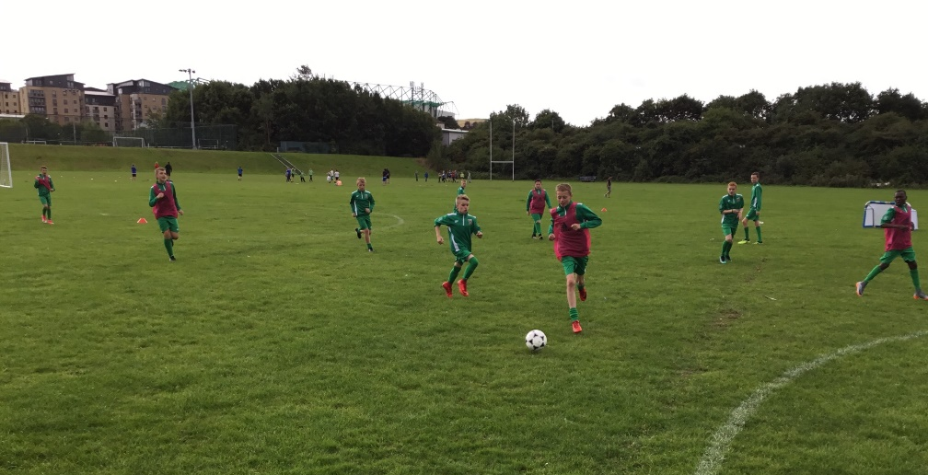

Slide 9
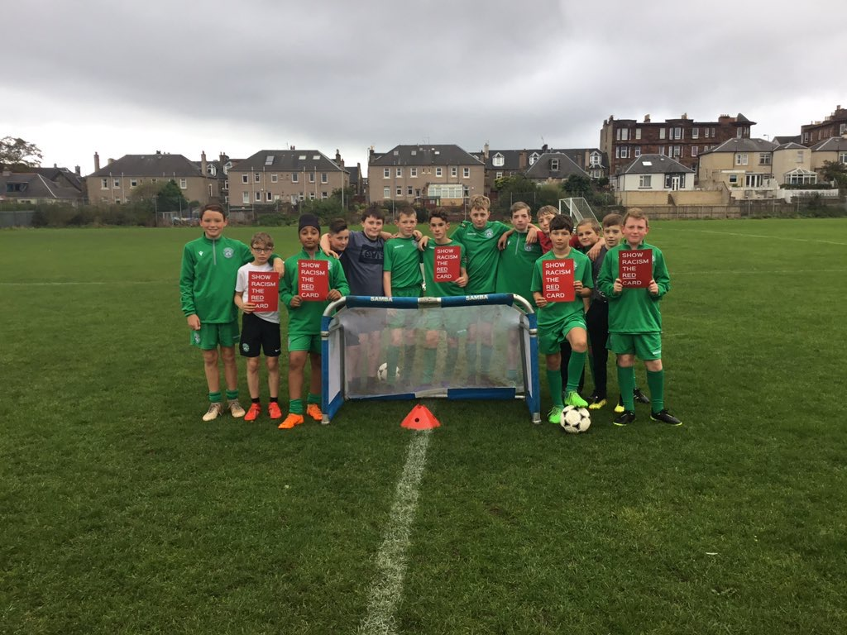
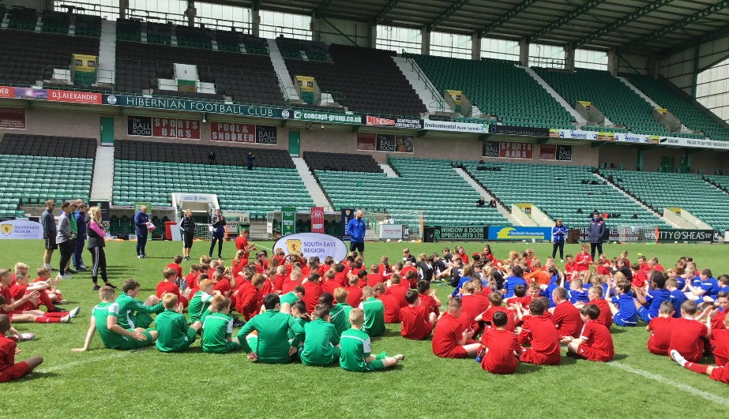
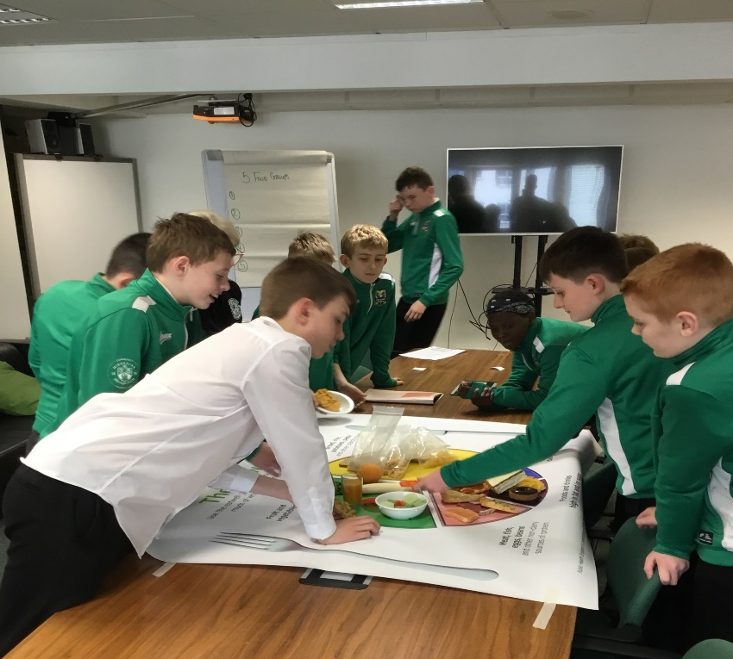
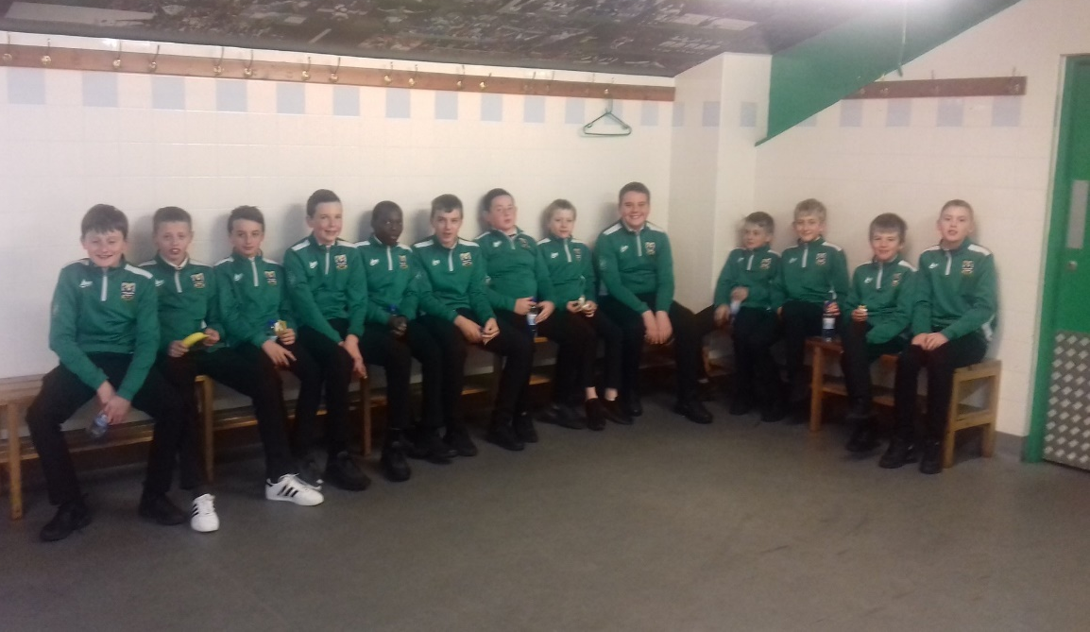

Slide 10
Selection Process
Our normal procedure for pupil selection would be through 2 practical training sessions and if successful pupils would then be invited to attend a interview with their parent/guardian.
This interview allows us to get to know the pupil better and inform the parent/guardian of the benefits the subject has on the strong majority of our pupils.
Obviously, due to COVID-19, we are unable to follow our usual procedure so I would like to invite al interested pupils to sign up to trials for when school resumes.

Slide 11
Application
To register interest please complete the following details and email it to steven.moffat@leith.edin.sch.uk.
Name:
Primary School:
DOB:
Clubs (If any):
Reason for applying to School of Football.
Contact email address:

